Slide 1

ELECTROSTATIC (COULOMB’S LAW)
FISIKA DASAR 2

Slide 2
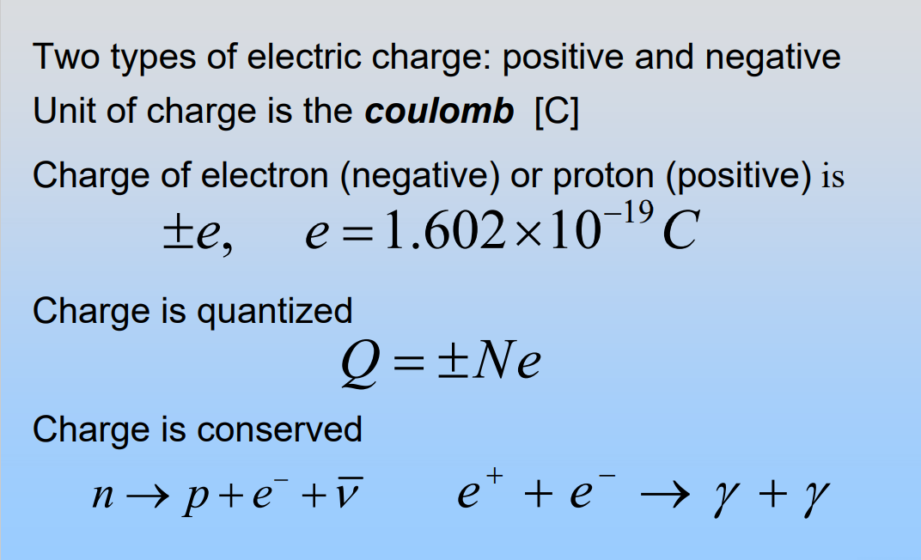

Electric Charge
Adopted from MIT Course

Slide 3
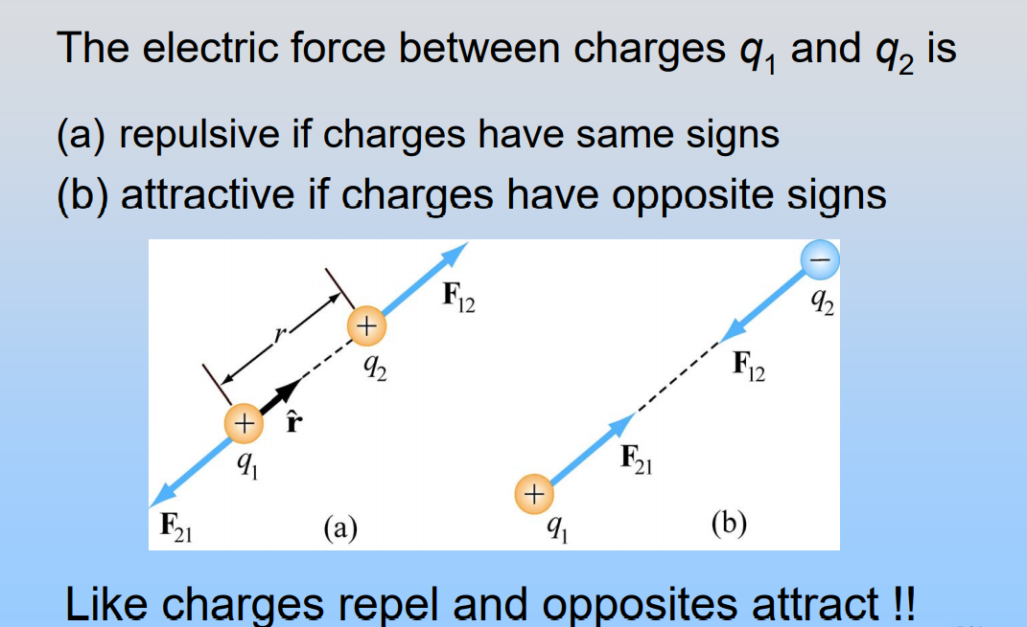
Electric Force
Adopted from MIT Course

Slide 4
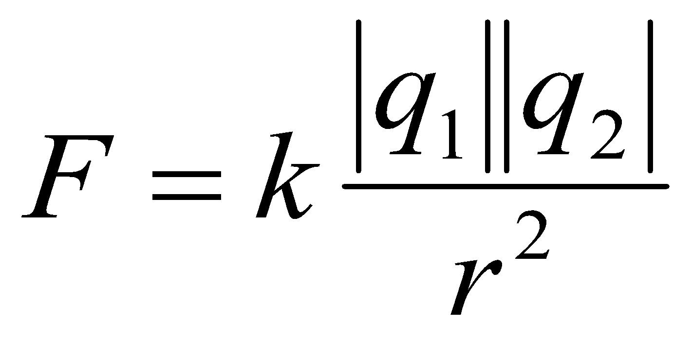
Electric Force
From Coulomb’s experiments, we can generalize the following properties of the electric force between two stationary charged particles. The electric force
is inversely proportional to the square of the separation r between the particles and directed along the line joining them;
is proportional to the product of the charges q₁ and q₂ on the two particles;
is attractive if the charges are of opposite sign and repulsive if the charges have the same sign;
is a conservative force.
q₁
q₂
r
F = Electric Force (N)
q₁,q₂ = charges (C)
r = separation between the particles (m)
k = 8,99 10⁹ N.m²/C²
Adopted from MIT Course

Slide 5
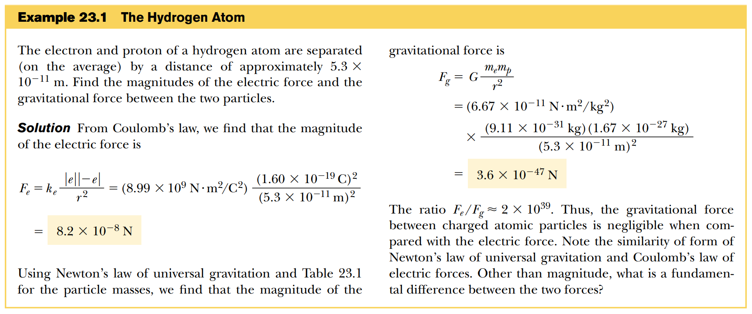
Electric Force

Slide 6
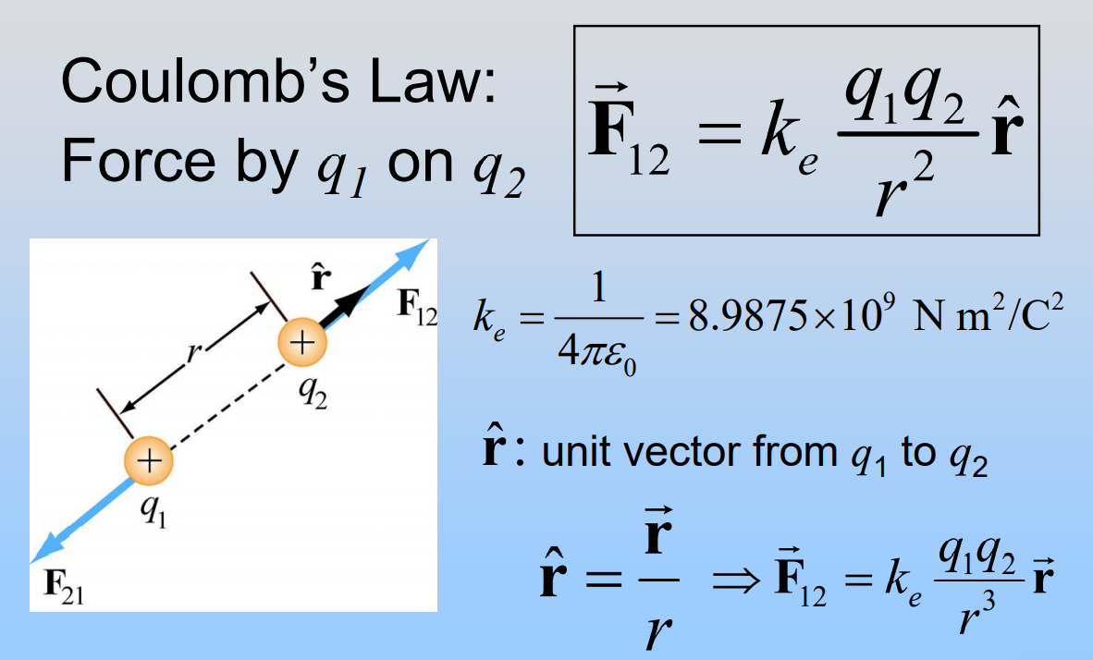
Coulomb’s Law : in vector form
Adopted from MIT Course

Slide 7

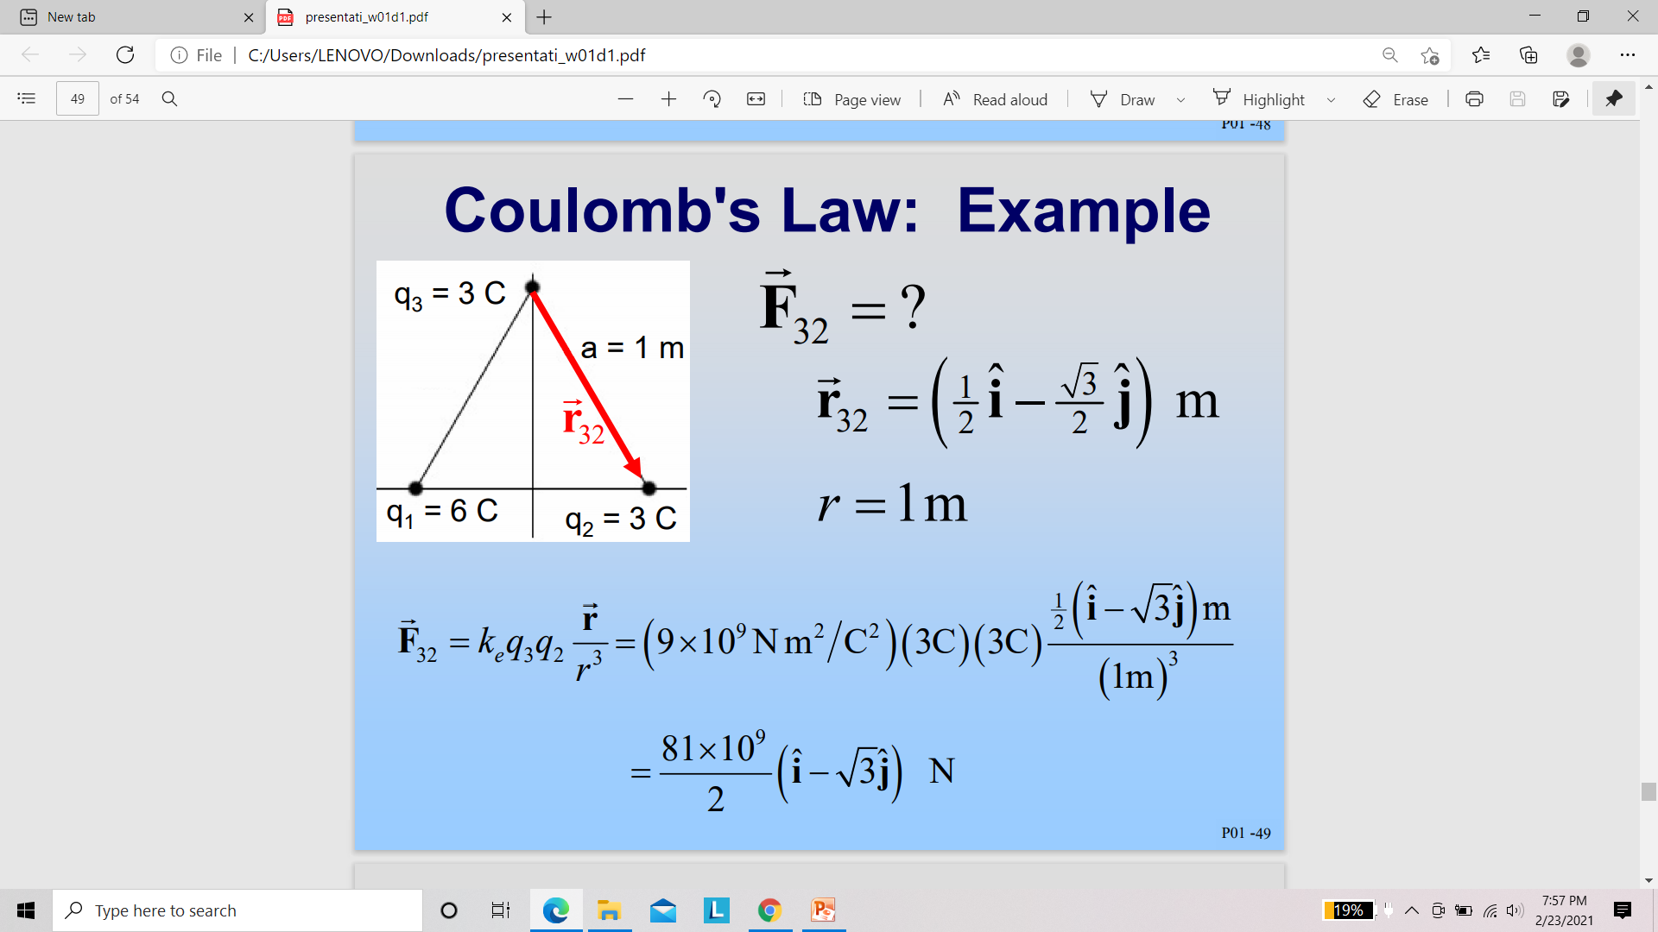


Coulomb’s Law : Example
q₃
a =1
½
½
q₁
0
q₂
r₁= − ½ i
r₂= ½ i
Adopted from MIT Course

Slide 8
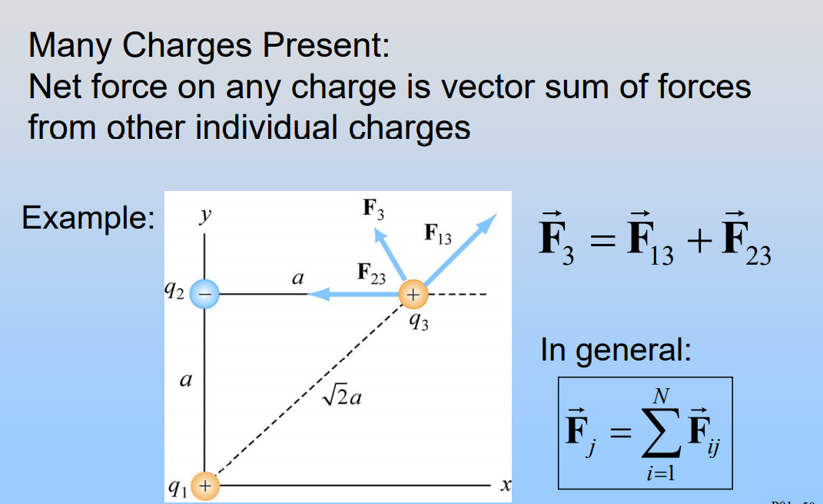
The Superposition Principle
Adopted from MIT Course

Slide 9
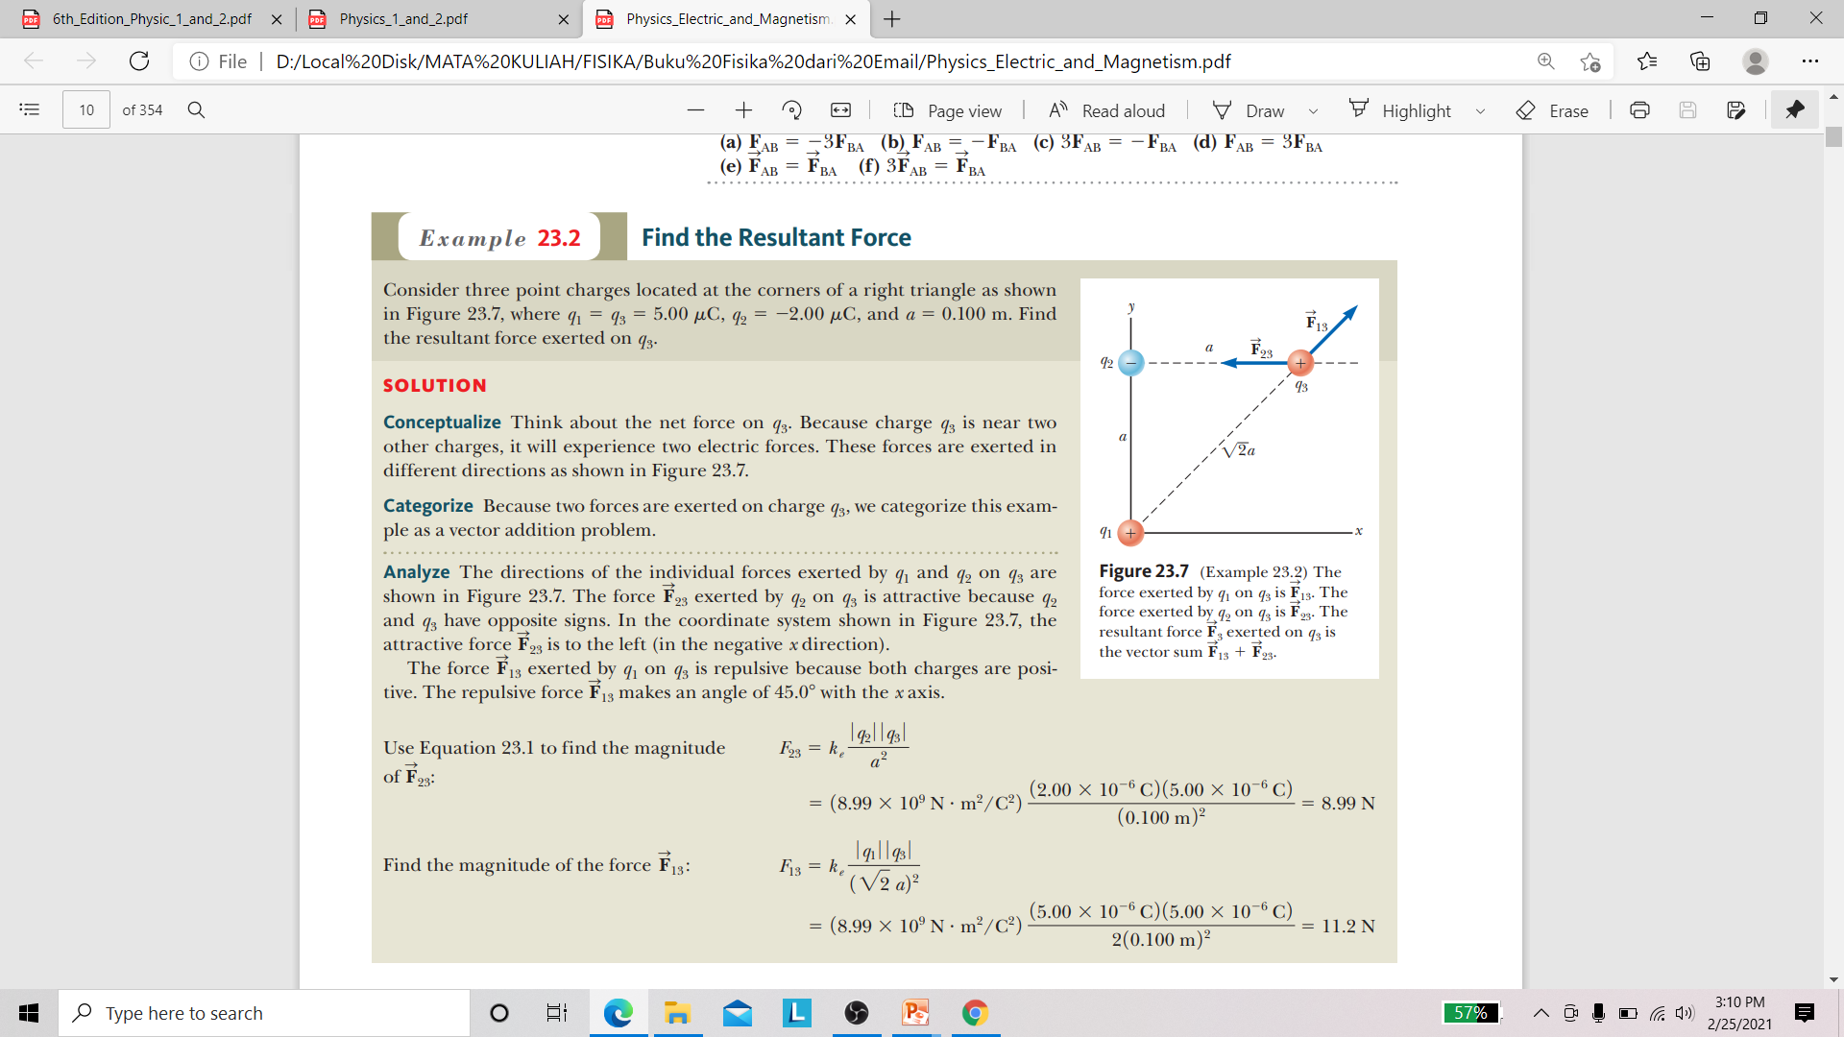
The Superposition Principle
F₂₃ = (−8.99 i ) N

Slide 10
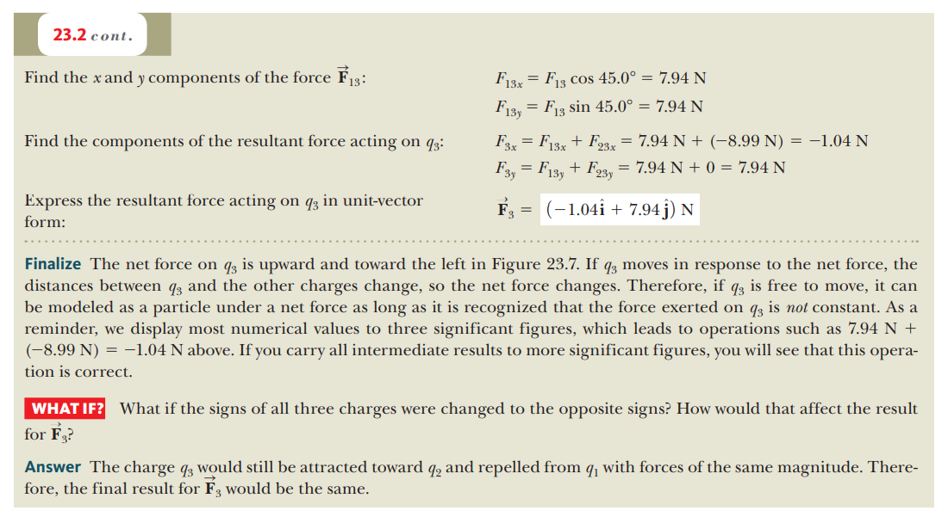
The Superposition Principle

Slide 11
SEKIAN - TERIMAKASIH

